Slide 1
Gluten Intolerance
Student’s Name
Institutional Affiliation

Slide 2
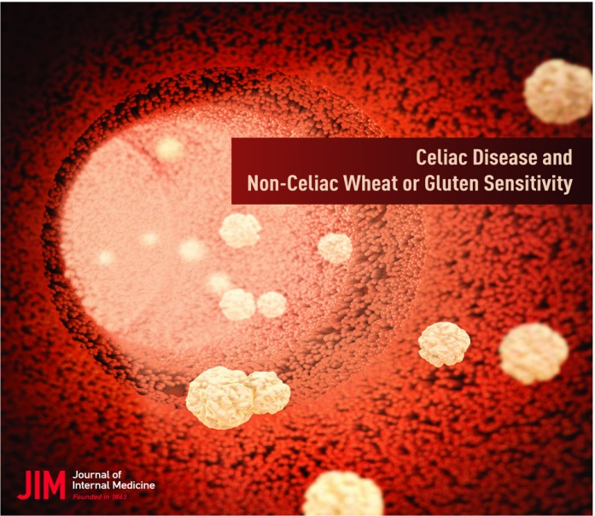
Gluten Insensitivity (GI)
Gluten is a protein element that is found in barley, wheat, and rye
Persons that are intolerant to the element experience bloating and pain in the stomach
Gluten intolerance is analogous disorder known as celiac disease
Other symptoms include:
Diarrhea
Nausea
Constipation
Abdominal pain
Feelings of being unwell

Slide 3
Health Problem
There is an overlap in the symptoms of the disorders and those of other gastrointestinal illnesses
The pathophysiology of the disorder is unknown
There is a great debate whether gluten insensitivity is caused by other components of wheat rather than gluten (Barbaro et al., 2018).
The prevalence of the disease has been determined to be greater than that of celiac disease
The diagnosis of the disorder can be done through place-controlled intervention
However, the procedure is complex and has narrow applicability in clinical practice

Slide 4
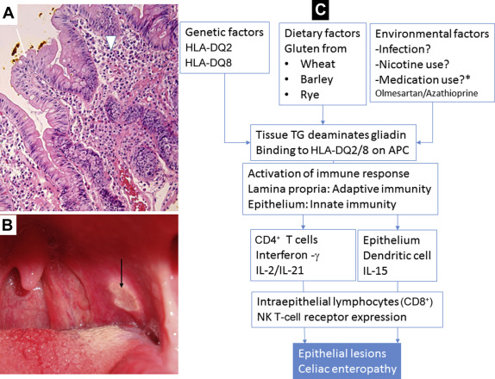
Recent Advancements
There is need for diagnostic markers for the intervention to be effective
FOODMAPs are wheat elements that play an integral part in the pathophysiology of the disease (Barbaro et al., 2018).
Empirical evidence shows that GI symptoms reduce when FOODMAP intake is reduced
The studies have determined that wheat elements including FOODMAPs cause GI
It has also been determined that fructans contained in FOODMAPs cause GI

Slide 5
Cont.
Other empirical studies have determined that GI is a multi-factor-onset disorder
Therefore, it is preventable or temporal alluding to balanced diet
Albumin proteins that represent 4% of grains’ total proteins are also contributing factors (Biesiekierski, 2017).
They induce the secretion of pro-inflammatory cytokines that activates GI in the victims.
The proteins activate innate immune cells that cause intestinal inflammation

Slide 6

Cont.
Gluten has been found to gluten has biological characteristics that alters the cellular morphology.
There are Gliadin peptides bind receptors that enhances the production of proinflammatory cytokine.
Gluten has key protein mediator that increase mucosal permeability.
In this regard, exposure of intestinal cells reduce their survival.
As a result, it reduces protein synthesis and nucleic acid.

Slide 7
References
Barbaro, M. R., Cremon, C., Stanghellini, V., & Barbara, G. (2018). Recent advances in understanding non-celiac gluten sensitivity. F1000Research, 7, 1631. https://doi.org/10.12688/f1000research.15849.1
Biesiekierski, J. R. (2017). What is gluten? Journal of Gastroenterology and Hepatology, 32, 78–81. https://doi.org/10.1111/jgh.13703
Casella, G., Villanacci, V., Di Bella, C., Bassotti, G., Bold, J., & Rostami, K. (2018). Non celiac gluten sensitivity and diagnostic challenges. Gastroenterology and Hepatology from Bed to Bench, 11(3), 197–202. https://www.ncbi.nlm.nih.gov/pubmed/30013742
‌

